Slide 1
Modern Analytics Academy
Data Governance with Azure Purview
https://aka.ms/maa

Slide 2





Modern Analytics Academy Team
Alex Karasek
Annie Xu
Brian Hitney
Chris Mitchell
Jason Virtue
Senior Cloud Solution Architect
Senior Cloud Solution Architect
Senior Cloud Solution Architect
Principal Cloud Solution Architect
Principal Cloud Solution Architect
https://aka.ms/maa

Slide 3





Academy Sessions
Acquisition & Storage
Modeling
Pipelines
Data Governance
Visualization
Azure Data Lake
Azure Cosmos DB
Azure Event Hubs
Synapse Link
Data Lake Structure
Synapse Spark Pools
Synapse SQL Pools
Synapse Serverless SQL
Azure Data Factory
Synapse Pipelines
Power BI Dataflows
Azure Stream Analytics
Azure Purview
Discovery, Classification, Lineage
Power BI
Paginated Reports
Power BI Embedded
Notes:
Let’s take a quick look at the detailed sessions available.
In Data Acquisition and Storage we’ll look at the nuances of how source systems provide you and the various mechanisms for getting that data into Azure for long term retention and analysis.
In Data Modeling we’ll be looking at how to structure and store your data for the purposes of serving data to applications like reporting tools.
In Data Pipelines we’ll be looking at how to move your data through a data engineering process the prepare the data for serving.
In Data Security and Governance we’ll examine how to deal with topics like controlling access to your data, understanding the lineage of your data and addressing policy compliance on your data.
In Data Visualization we’ll examine how visualization tools can be used to enable users to get timely business value out of your data.

Slide 4
Agenda
What is Data Governance?
Azure Purview Components
Demos
Cost & Scale

Slide 5
What is data governance?
“Data Governance is defined as the exercise of authority and control (planning, monitoring, and enforcement) over the management of data assets.”
Source: DAMA Data Management Body of Knowledge V2 (DMBOK2)
“Data governance encompasses the people, processes, and technology required to create a consistent and proper handling of an organization's data across the business enterprise.”
Source: Wikipedia
“Data governance is the orchestration of people, processes, policies and technology to formally manage and protect structured and unstructured data assets to guarantee commonly understood, trusted and secure data throughout the enterprise”
Source: Mike Ferguson, Intelligent Business Strategies

Slide 6




Data governance is becoming increasingly interdisciplinary
DISCOVERY
COMPLIANCE
What data do I have?
Where did the data originate?
Can I trust it?
What’s my exposure to risk?
Is my usage compliant?
How do I control access & use?
What is required by regulation X?
Chief Data Officer

Slide 7
What is in a data governance framework?
Data governance vision and strategy
People
Processes
Policies
Technology
Data lifecycle
Data
Create
Protect
Store
Use
Maintain
Archive
Destroy
Edge
Data center
Multiple clouds

Slide 8
Roles and responsibilities for accountability
Who sets success metrics & monitors how well the governance program is working?
Who are the data owners?
Who defines and maintains a business glossary?
Who creates and maintains policies on access security?
Who is protecting PII data privacy for compliance with GDPR & CCPA?
Who is looking after the quality of product data across all brochures and partner websites?
Who ensures customer data is consistent across all systems?
Who is policing external subscription data usage vs license?
Who is policing privileged users like DBAs?
GRC Manager
CxO
Legal
Department head
IT
GRC = Governance, Risk and Compliance

Slide 9
Data governance classification schemes
Data confidentiality classification scheme
Data retention classification scheme
Confidential | Description
Public | Anyone can access, Can be sent to anyone e.g. open government data
Internal use only | Employees only can access Cannot be sent outside the company
Confidential | Should be shared only if needed for a specific task Cannot be sent outside the company without a non-disclosure agreement
Sensitive (PII) Personally identifiable information | Must be masked and shared only on a need to know basis for a limited time Cannot be sent to unauthorized personnel or outside the company
Restricted | Only to be shared with named individuals who are accountable for its protection e.g. legal documents, Trade secret (Coca Cola recipe)
Retention | Description
None | No need to keep the data
Temporary | Short lived e.g. keep twitter data for a week
Fixed period | Set number of years e.g. keep tax records for 7 years to comply with government laws after which it can be deleted
Permanent | Never to be deleted e.g. Legal correspondence

Slide 10

Reimagine data governance in the cloud
Manage and govern operational, transactional and analytical data
Cloud-native, purpose-built service to address discovery and compliance needs
Fully managed, serverless, PaaS service
Eliminate manual, ad-hoc and homegrown solutions

Slide 11

Establish the foundation for effective data governance
Automate discovery of data in on-premises, multicloud and SaaS sources
Classify data at scale to specify sensitivity, compliance, industry, business and company-specific value
Know where data came from and what was derived from it with data lineage

Slide 12

Maximize business value of data
Connect business and technical data analysts, data scientists, and data engineers to a trusted data catalog
Enable users to quickly find data and view its lineage and sensitivity
Deliver a curated and consistent glossary of business terms and definitions

Slide 13

Gain insight into data use across the estate
Understand at a glance how data is being created and used across your data estate
Visually assess the state of data assets, scans, business glossary and sensitive data

Slide 14

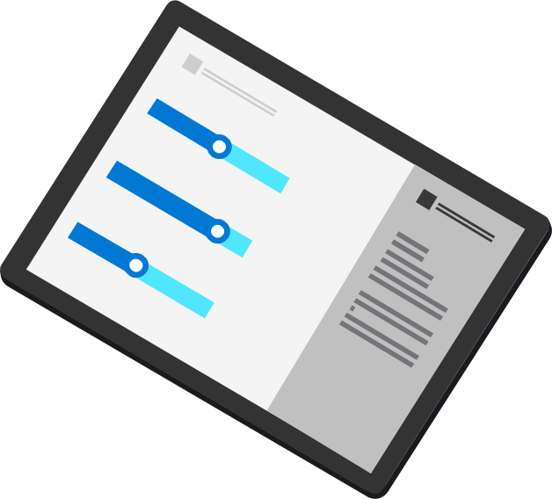
Azure Purview
Azure Purview
UNIFIED DATA GOVERNANCE
Data Insights
Data Map
Automate and manage metadata at scale
Data Catalog
Data Catalog
Enable effortless discovery for data consumers
On-prem
Multicloud
Data Map
Data Insights
Assess data usage across your organization
SaaS

Slide 15
Azure Purview: Unified Data Governance
Azure Purview
Power BI
SQL Server on-prem
Azure Synapse
Azure Data Services
M365 Compliance Center
Unified Experience
Data Catalog
Data Insights
Search
Business Glossary
Lineage
Data use reports
Publish, Discover & Curate Data
Unified Platform
“Data Map” = Data Assets | Lineage | Classifications
Open APIs
Automated Scanning & Classification
(Apache Atlas 2.0)
On-prem & Multicloud Operational, Analytical, SaaS

Slide 16
Demo
Introduction to Purview

Slide 17
Demo
Data Sources &
Data Lineage

Slide 18
Metadata lineage
Data sources
Data ingestion
Data processing
Data storage
Data reporting
CREATE
UPDATE
DELETE
Data maintenance

Slide 19
Metadata lineage
Data sources
Data ingestion
Data processing
Data storage
Data reporting
Native Support
Apache Atlas hooks
REST API
CREATE
UPDATE
DELETE
Data maintenance

Slide 20
Demo
Purview Insights

Slide 21
Azure Purview
Azure Purview
UNIFIED DATA GOVERNANCE
Data Insights
Data Map
Automate and manage metadata at scale
Data Catalog
Data Catalog
Enable effortless discovery for data consumers
On-prem
Multicloud
Data Map
Data Insights
Assess data usage across your organization
SaaS

Slide 22
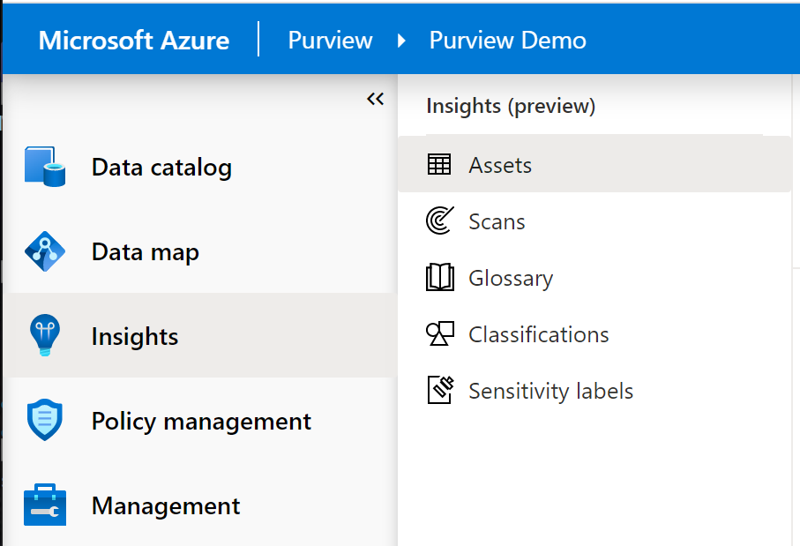
Purview Studio
Insights

Slide 23
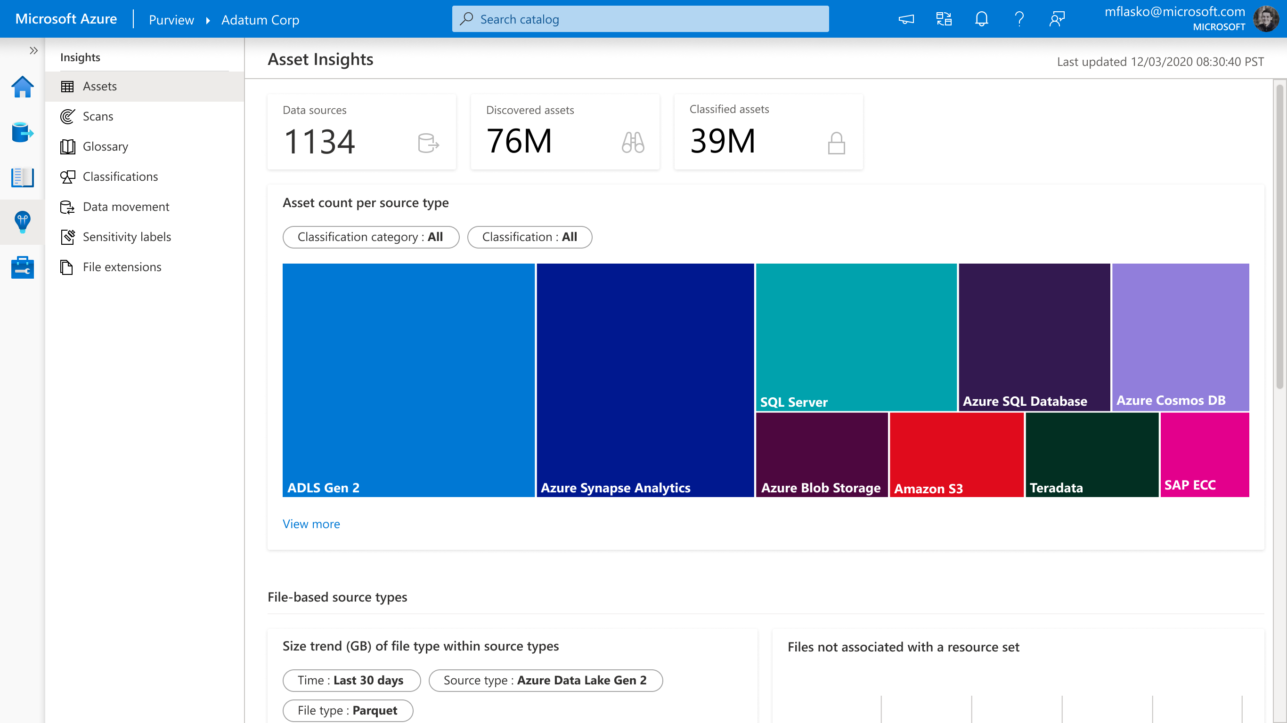
Azure Purview> Studio > Insights > Assets
Asset Insights
Understand distribution of data assets across a range of data sources & environments

Slide 24
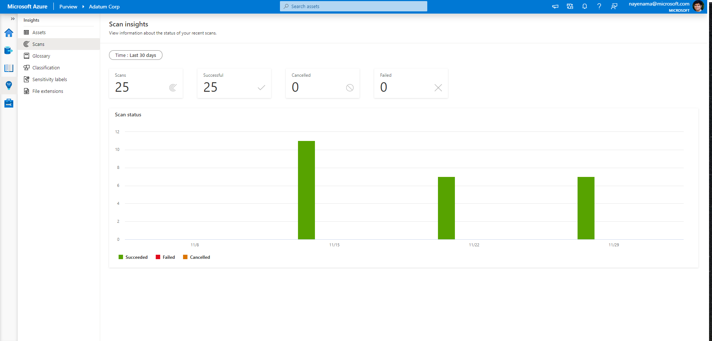
Azure Purview> Studio > Insights > Scans
Scan Insights
Number of successful, failed and cancelled scans over time

Slide 25
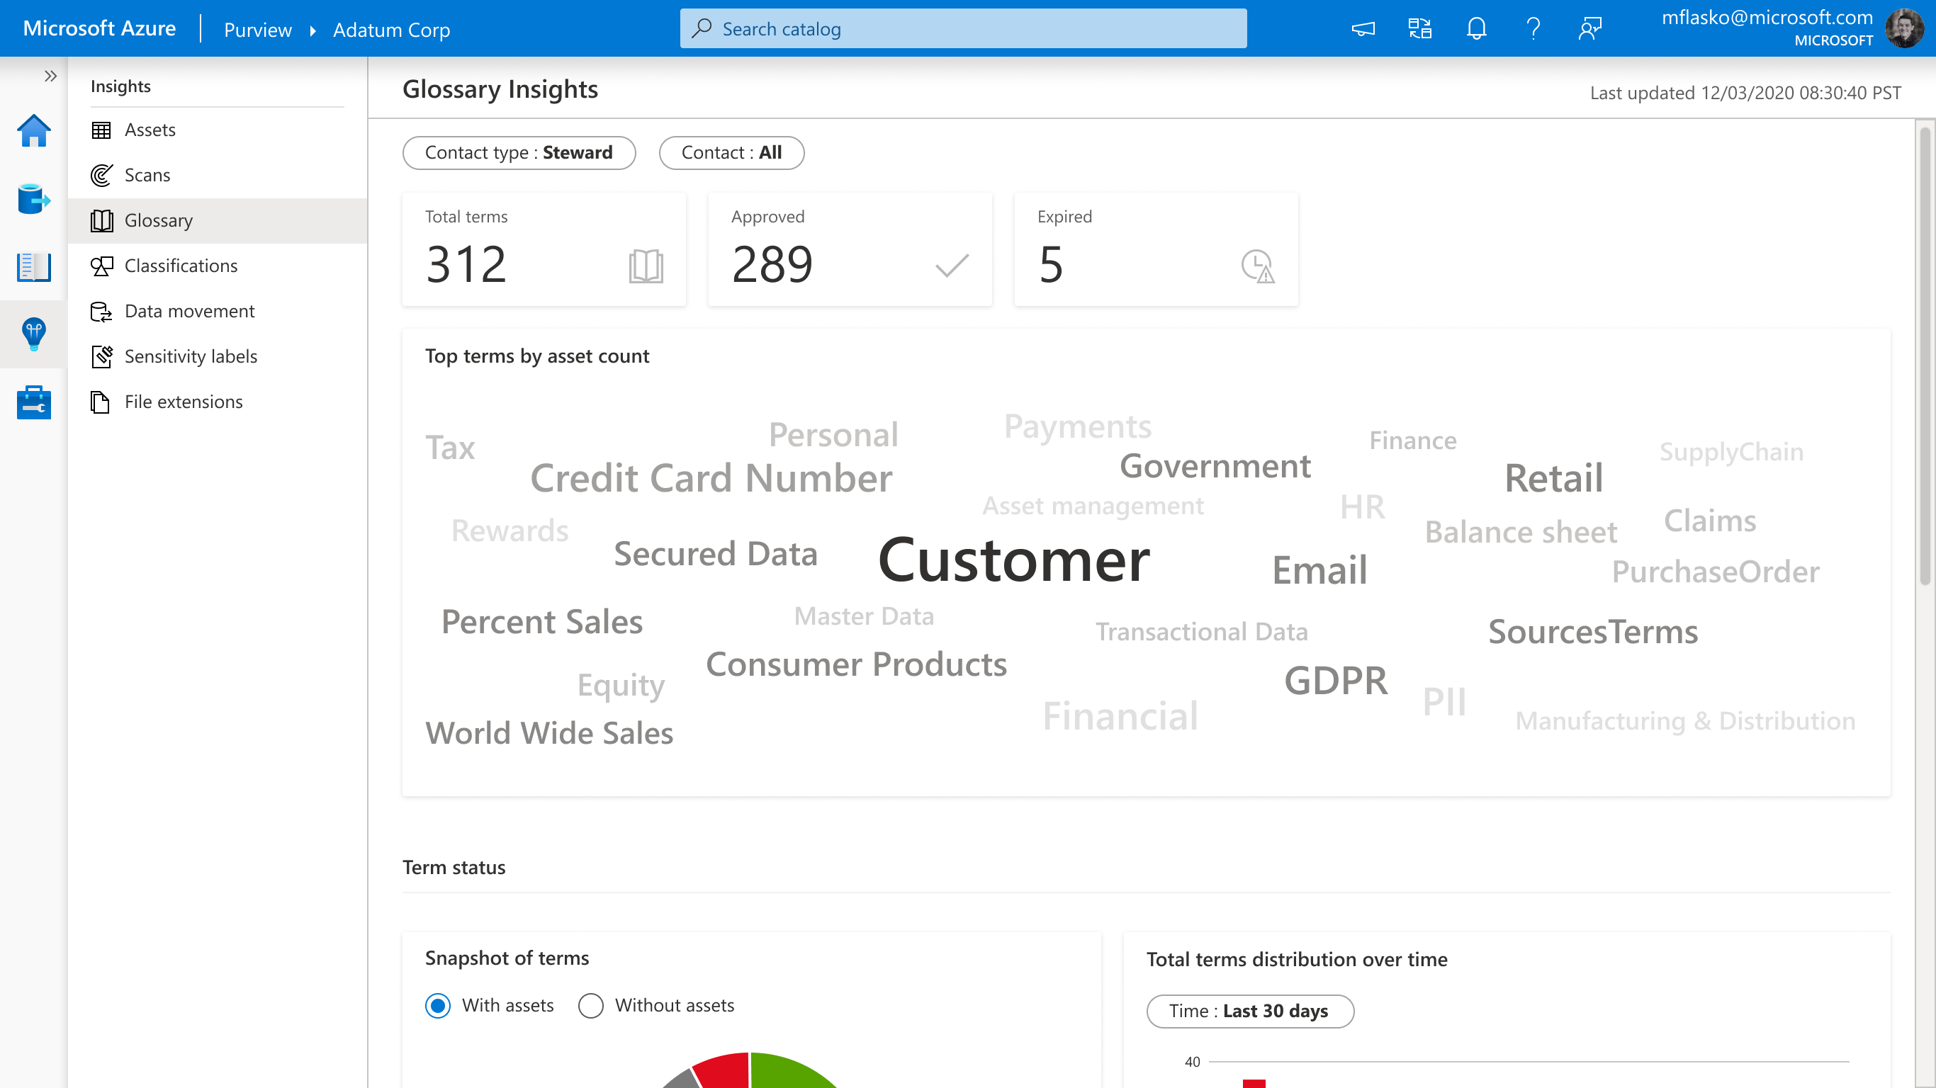
Azure Purview> Studio > Insights > Glossary
Glossary Insights
Understand changes made to business terms and assess how much coverage glossary has over the data map

Slide 26
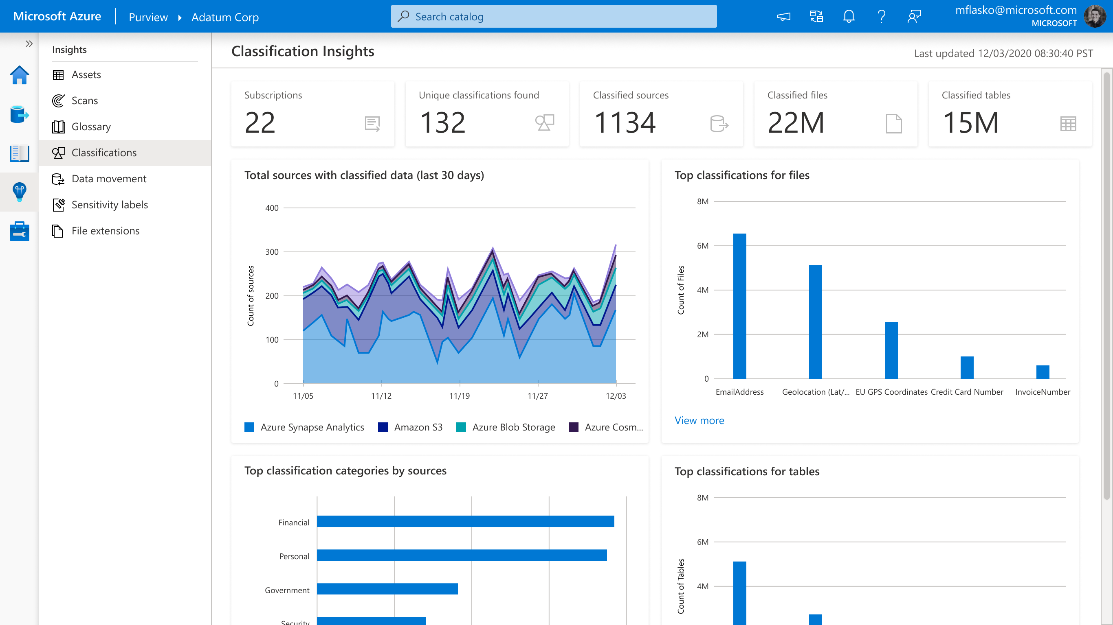
Azure Purview> Studio > Insights > Classifications
Classifications Insights
Understand what sensitive data exists across the data estate from various lens

Slide 27
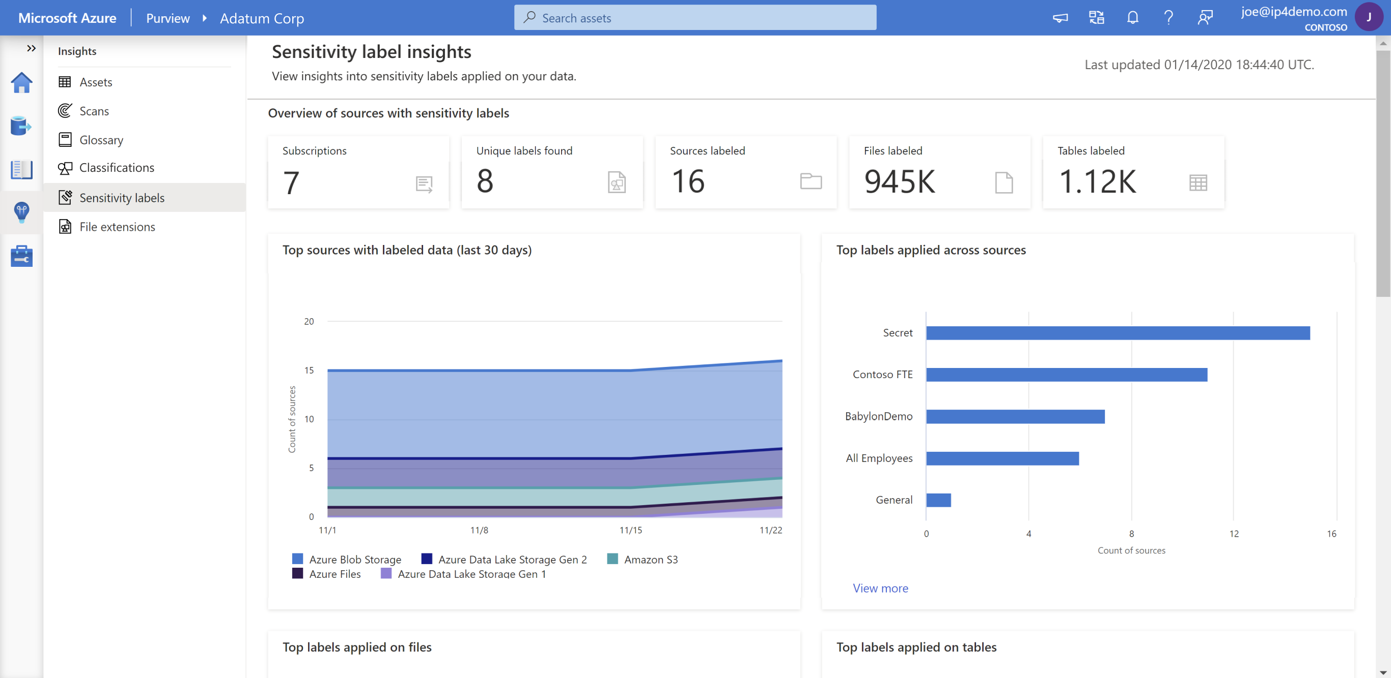
Azure Purview> Studio > Insights > Sensitivity labels
Sensitivity Labels Insights
Understand what sensitivity labels have been applied across the data estate

Slide 28
Azure Purview
Pricing

Slide 29
Purview Pricing Direct Costs
Elastic data map
Provisioned at 1 CU / 2 GB metadata storage.
~25 data map operations per second
Scales between min/max limits based on throughput and storage
$0.411 per 1 CU hour
Scanning & Classification
For Power BI and SQL Server on-premises, currently free for a limited time
$0.63 per 1 vCore hour (while scanning)
Advanced Resource Sets
Optional, used to address complex or custom data lake hierarchy. Off by default.
Needed for constantly changing schema, or when additional data points (such as partition count, total size) is needed.
Based on compute needed to aggregate resource sets.
$0.21 per 1 vCore hour (while scanning)

Slide 30
Purview Pricing Direct Costs
Azure Purview Data Catalog
C0 - Search/browse data assets
Included in Data Map
C1 - Business glossary, lineage
Free in preview
Catalog Insights
Free in preview

Slide 31
Purview Pricing Indirect Costs
Managed resources for every Purview Account, such as a storage account and event hub.
Private endpoint, if required
Self-hosted IR, for data sources on-premises
M365 Information Protection (MIP) for sensitivity labels.
Multi-cloud egress charges

Slide 32
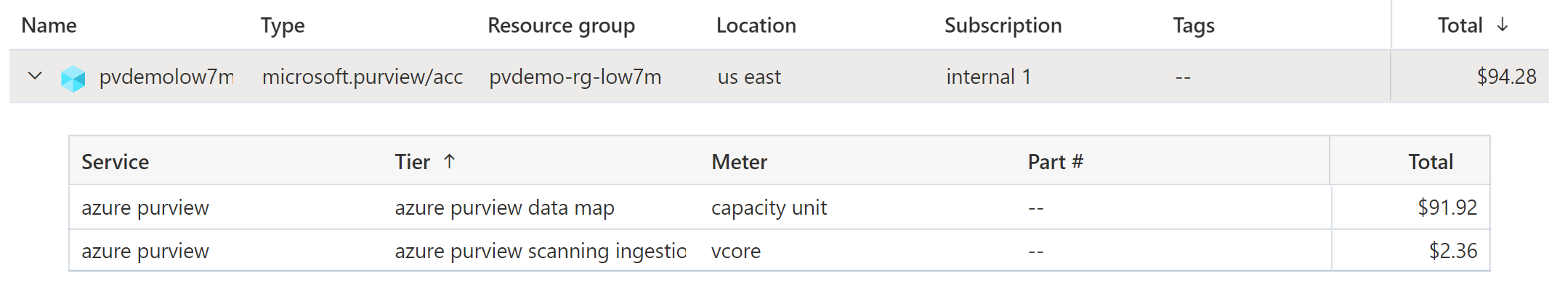
Example
Data Map:
# CUs X $0.411 * 730 hours
1 CU x $0.411 * 730 = $300.03
Scanning:
Dur (min) of scans / 60 min/hr * 32 vCore * $0.63
300 min / 60 * 32 vCore * $0.63 = $100.80

Slide 33
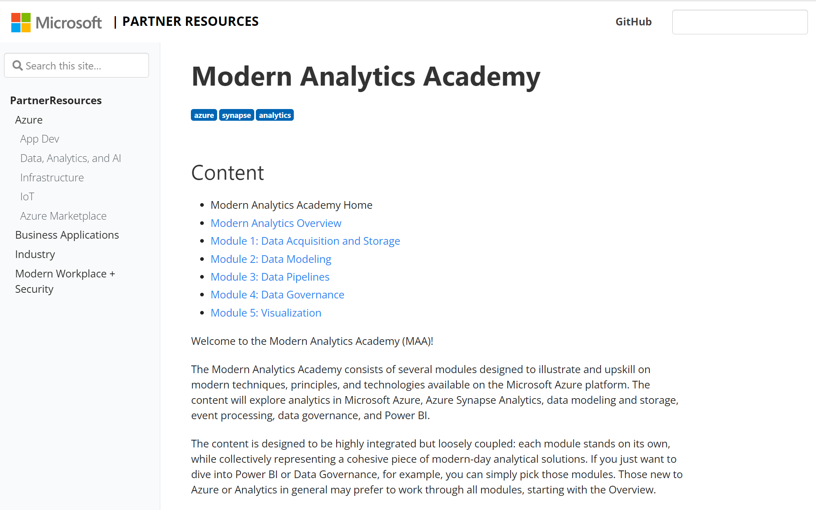
Modern Analytics Academy https://aka.ms/maa
Data Governance
with Azure Purview
Thank you!

